Slide 1


Macroeconomics
Ninth Edition
Chapter 3
Where Prices Come From: The Interaction of Demand and Supply
Copyright © 2025, 2021, 2018 Pearson Education, Inc. All Rights Reserved
Notes:
If this PowerPoint presentation contains mathematical equations, you may need to check that your computer has the following installed:
1) MathType Plugin
2) Math Player (free versions available)
3) NVDA Reader (free versions available)

Slide 2
Chapter Outline
3.1 The Demand Side of the Market
3.2 The Supply Side of the Market
3.3 Market Equilibrium: Putting Demand and Supply Together
3.4 The Effect of Demand and Supply Shifts on Equilibrium

Slide 3
A Water Bottle as a Status Symbol?
In recent years, reusable water bottles have become fashionable; for example:
W S J referred to Stanley Quencher as “the new office status symbol.”
The Yeti Rambler is a “cult favorite.”
Some “smart” water bottles even interact with smartphone apps.
How do these changes in tastes affect prices and quantities?

Slide 4
Our Model of a Market
To analyze the market for Nike athletic shoes or anything else, we need a model of how buyers and sellers behave.
The model we use in this chapter is a perfectly competitive market, a market with (1) many buyers and sellers, (2) all firms selling identical products, and (3) no barriers to new firms entering the market.
While these assumptions are quite restrictive, the model is still useful for analyzing many markets.

Slide 5
3.1 The Demand Side of the Market
List and describe the variables that influence demand.
We begin our analysis of where prices come from by investigating how buyers behave.
We refer to this as market demand, the demand by all the consumers of a given good or service.

Slide 6
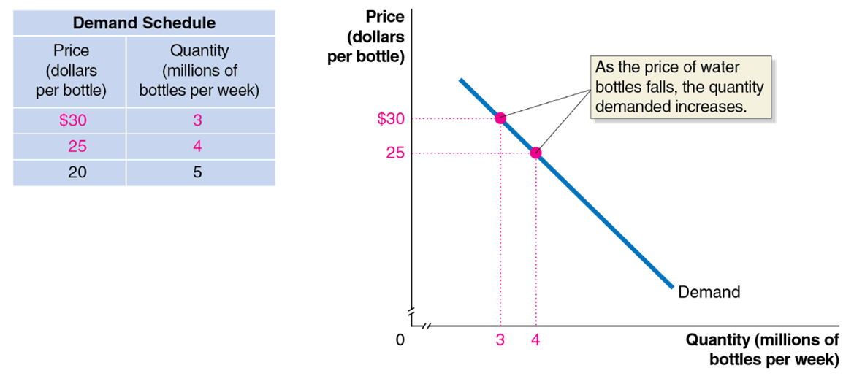
Figure 3.1 A Demand Schedule and Demand Curve (1 of 3)
Demand schedule: A table that shows the relationship between the price of a product and the quantity of the product demanded.
Demand curve: A curve that shows the relationship between the price of a product and the quantity of the product demanded.
Notes:
The demand schedule is as follows. • Price in dollars per bottle, $30. Quantity in millions of bottles per week, 3. (Highlighted). • Price in dollars per bottle, 25, Quantity in millions of bottles per week, 4. (Highlighted). • Price in dollars per bottle, 20, Quantity in millions of bottles per week, 5. On the truncated graph, the X axis represents quantity in millions of bottles per week, and the Y axis represents price in dollars per bottle. A line falls through the tabulated points and is labeled, as the price of water bottles falls, the quantity demanded increases.

Slide 7
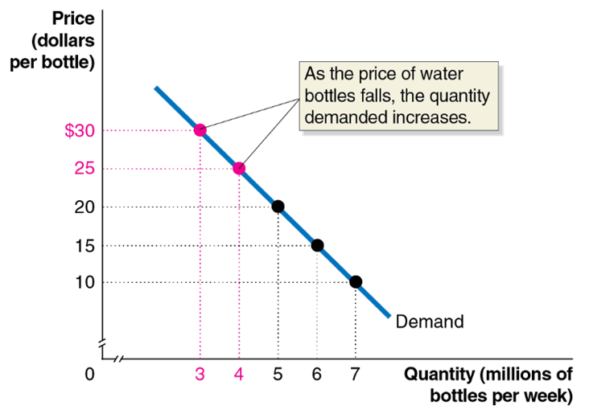
Figure 3.1 A Demand Schedule and Demand Curve (2 of 3)
Quantity demanded: The amount of a good or service that a consumer is willing and able to purchase at a given price.
Law of demand: A rule that states that, holding everything else constant, when the price of a product falls, the quantity demanded of the product will increase, and when the price of a product rises, the quantity demanded of the product will decrease.
Notes:
On the truncated graph, the X axis represents quantity in millions of pairs of bottles per week, and the Y axis represents price in dollars per bottle. A line falls through the tabulated points and is labeled, as the price of water bottles falls, the quantity demanded increases.

Slide 8
What Explains the Law of Demand?
When the price of a good falls, two effects take place:
Consumers substitute toward the good whose price has fallen.
Consumers have more purchasing power, which is like an increase in income.
We call these the substitution effect and the income effect:
Substitution effect: The change in the quantity demanded of a good that results from a change in price, making the good more or less expensive relative to other goods, holding constant the effect of the price change on consumer purchasing power.
Income effect: The change in the quantity demanded of a good that results from the effect of a change in the good’s price on a consumer’s purchasing power, holding all other factors constant.

Slide 9
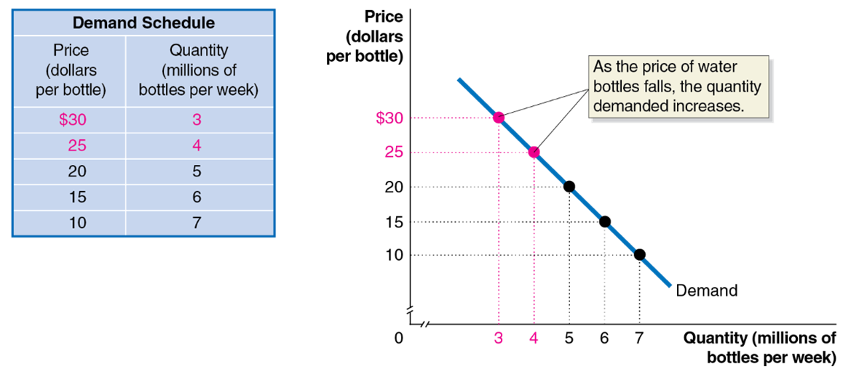
Figure 3.1 A Demand Schedule and Demand Curve (3 of 3)
When drawing the demand curve, we assume ceteris paribus.
Ceteris paribus (“all else equal”) condition: The requirement that when analyzing the relationship between two variables—such as price and quantity demanded—other variables must be held constant.
Notes:
The demand schedule is as follows. • Price in dollars per bottle, $30. Quantity in millions of bottles per week, 3. (Highlighted). • Price in dollars per bottle, 25, Quantity in millions of bottles per week, 4. (Highlighted). • Price in dollars per bottle, 20, Quantity in millions of bottles per week, 5. • Price in dollars per bottle, 15, Quantity in millions of bottles per week, 6. • Price in dollars per bottle, 10, Quantity in millions of bottles per week, 7. On the truncated graph, the X axis represents quantity in millions of bottles per week, and the Y axis represents price in dollars per bottle. A line for demand falls through the tabulated points and is labeled, as the price of water bottles falls, the quantity demanded increases.

Slide 10
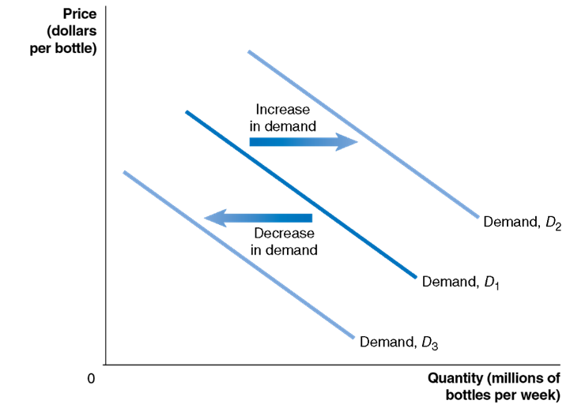
Figure 3.2 Shifting the Demand Curve (1 of 2)
A change in something other than price that affects demand causes the entire demand curve to shift.
A shift to the right
is an increase in demand.
A shift to the left
is a decrease in demand.
Notes:
The X axis represents the quantity in millions of bottles per week, and the Y axis represents the price in dollars per bottle. There are 3 downward trending lines, demand D sub 1 falls through the center of the graph. As demand increases the demand curve shifts to the right and is labeled, D sub 2. As demand decreases, the demand curve shifts to the left and is labeled, D sub 3.

Slide 11
Figure 3.2 Shifting the Demand Curve (2 of 2)
As the demand curve shifts, the quantity demanded will change, even if the price doesn’t change.
The quantity demanded changes at every possible price.
Notes:
The X axis represents the quantity in millions of bottles per week, and the Y axis represents the price in dollars per bottle. There are 3 downward trending lines, demand D sub 1 falls through the center of the graph. As demand increases the demand curve shifts to the right and is labeled, D sub 2. As demand decreases, the demand curve shifts to the left and is labeled, D sub 3.

Slide 12
Variables That Shift Market Demand
Income
An increase in income increases demand if the product is normal, and decreases demand if the product is inferior.
Prices of related goods
An increase in the price of related goods increases demand if products are substitutes, and decreases demand if products are complements.
Tastes
Population and demographics
Expected future prices
Natural Disasters and Pandemics
We will discuss how each of these affect demand.

Slide 13
Changes in Income of Consumers
Normal good: A good for which the demand increases as income rises and decreases as income falls.
Examples:
New clothes
Restaurant meals
Vacations
Inferior good: A good for which the demand increases as income falls and decreases as income rises.
Examples:
Second-hand clothes
Instant noodles

Slide 14
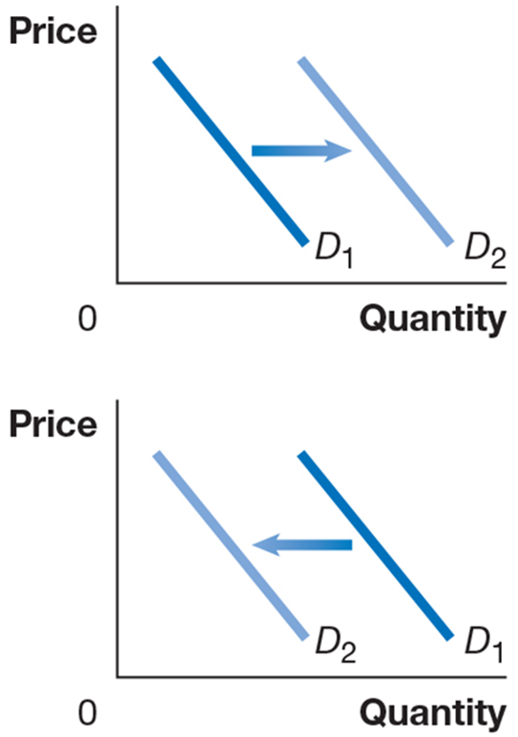
Effects of Changes in Income
An increase in income would increase the demand for new clothes, ceteris paribus.
However, the same increase in income would likely decrease the demand for second-hand clothes.
Notes:
D sub 1 falls through the graph, and an increase shifts up D sub 2. On a graph, the X axis represents quantity, and the Y axis represents price. D sub 1 falls through the graph, and a decrease shifts down D sub 2.

Slide 15
Changes in the Price of Related Goods
Substitutes: Goods and services that can be used for the same purpose.
Examples:
Big Mac and Whopper
Ford F-150 and Dodge Ram
Reusable water bottles and bottled spring water
Complements: Goods and services that are used together.
Examples:
Big Mac and McDonald’s fries
Left shoes and right shoes
Reusable water bottles and gym memberships

Slide 16

Effects of Changes in the Price of Related Goods
An increase in the price of a reusable water bottle would increase the demand for bottled spring water.
However, the same increase in the price of a reusable water bottle would decrease the demand for gym memberships.
Notes:
D sub 1 falls through the graph, and an increase shifts up D sub 2. On a graph, the X axis represents quantity, and the Y axis represents price. D sub 1 falls through the graph, and a decrease shifts down D sub 2.

Slide 17
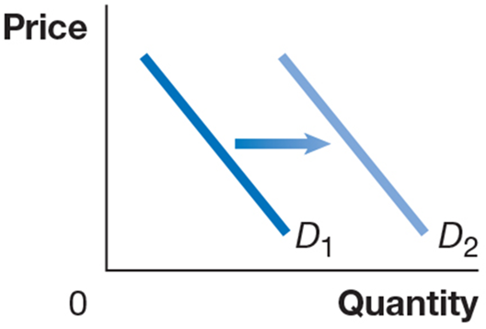
Changes in Tastes
Tastes
If consumers’ tastes change, they may buy more or less of the product.
Example: If influencers successfully advertise reusable water bottles, they affect consumers’ tastes, increasing demand for reusable water bottles.

Slide 18
Apply the Concept: When Did Most People Stop Wearing Hats?
The two photos show crowd scenes from the 1930s and 2022; almost everyone wore a hat in the first photo, but very few were doing so in the second.
Why? Most explanations involve changing tastes:
Wearing hats in cars is inconvenient.
Better climate control reduces the need to keep your head warm.
General trend toward less formal clothing.

Slide 19
Changes in Population/Demographics
Demographics: The characteristics of a population with respect to age, race, and gender.
Increases in the number of people buying something will increase the amount demanded.
Example: An increase in the elderly population increases the demand for medical care.

Slide 20
Apply the Concept: Millennials and Gen Z Are Changing Existing Markets
Millennials (born 1981-1996) and Gen Z (born 1997-2012) have different tastes than prior generations.
These groups are more likely than older generations to own reusable water bottles.
W S J: “Canned tuna is struggling to connect with younger generations.”
Harley Davidson’s “greatest challenge is to bring younger people into the sport” of riding motorcycles.

Slide 21
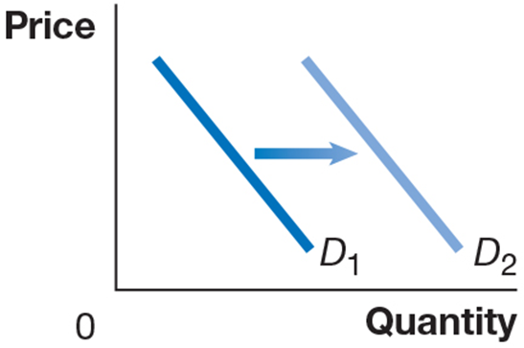
Changes in Expectations About Future Prices
Consumers decide which products to buy and also when to buy them.
Future products are substitutes for current products.
An expected increase in the price tomorrow increases demand today.
An expected decrease in the price tomorrow decreases demand today.
Example: If you found out the price of gasoline would go up tomorrow, you would increase your demand today.

Slide 22
Natural Disasters and Pandemics (1 of 3)
Temporary disruptions to economic activity can happen via natural disasters or pandemics.
Natural disaster: (in an economic context) A hurricane, flood, or similar act of nature that causes damage to stores, factories, or office buildings.
Pandemic: (in an economic context) A situation in which a disease becomes sufficiently widespread as to significantly affect economic activity.
Notes:
In the first graph, the line D sub 1 falls through the graph, and a decrease shifts down D sub 2. In the second graph, the line D sub 1 falls through the graph, and an increase shifts up D sub 2.

Slide 23
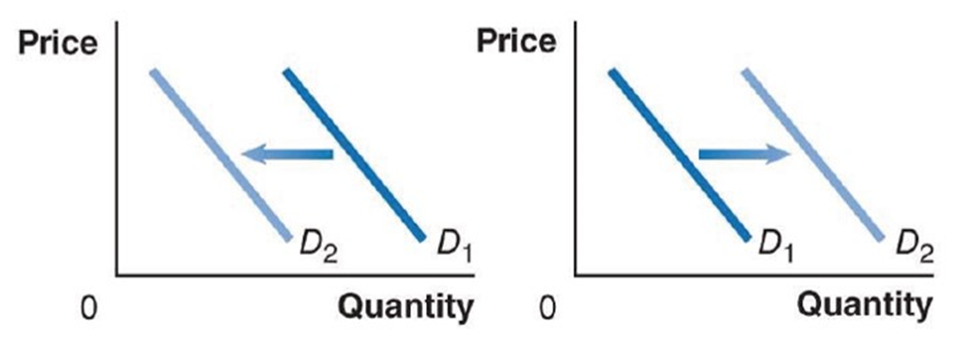
Natural Disasters and Pandemics (2 of 3)
Example: The Covid-19 pandemic reduced the demand for goods that required people gathering (restaurants, concert tickets, etc.) but increased the demand for computing equipment to work from home.
Notes:
In the first graph, the line D sub 1 falls through the graph, and a decrease shifts down D sub 2. In the second graph, the line D sub 1 falls through the graph, and an increase shifts up D sub 2.

Slide 24
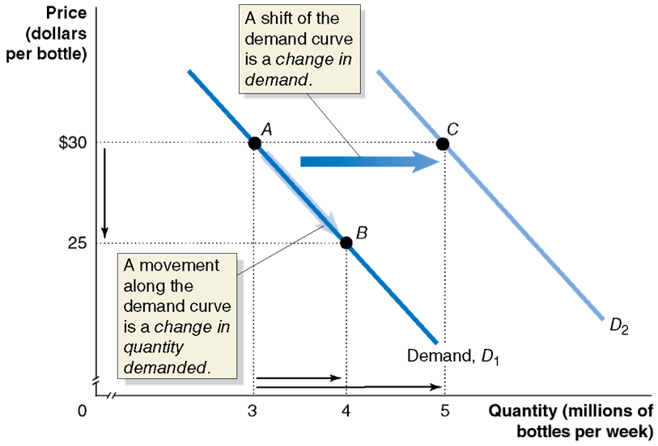
Figure 3.3 A Change in Demand versus a Change in Quantity Demanded
A change in the price of the product being examined causes a movement along the demand curve.
This is a change in quantity demanded.
Any other change affecting demand causes the entire demand curve to shift.
This is a change in demand.
Notes:
On a truncated graph, the X axis represents the quantity in millions of bottles per week, and the Y axis represents the price in dollars per bottle. The demand line D sub 1 falls through points A (3, $30) and B (4, $25). An arrow pointing from point A to point B indicates the movement along the demand curve is a change in the quantity demanded. The increased demand D sub 2, falls through point C (5, $30). An arrow pointing from D sub 1 and D sub 2 indicates the shift of the demand curve is a change in demand.

Slide 25
3.2 The Supply Side of the Market
List and describe the variables that influence supply.
There are some similarities, and some important differences, between the demand and supply sides of the market.
In this section, we examine the market supply, i.e., the decisions of (generally) firms about how much of a product to provide at various prices.

Slide 26
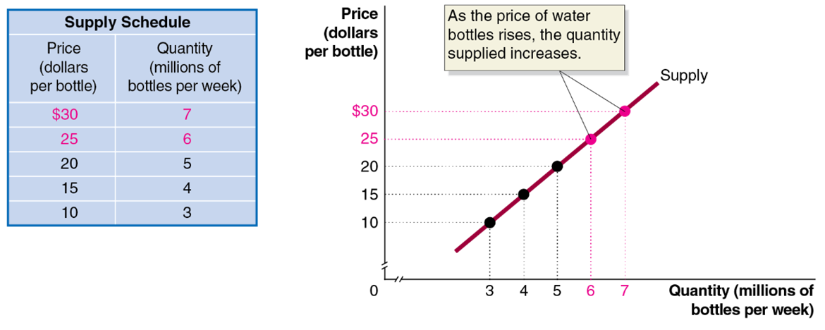
Figure 3.4 A Supply Schedule and Supply Curve (1 of 2)
Supply schedule: A table that shows the relationship between the price of a product and the quantity of the product supplied.
Supply curve: A curve that shows the relationship between the price of a product and the quantity of the product supplied.
Notes:
The supply schedule is as follows. • Price in dollars per bottle, $30. Quantity in millions of bottles per week, 7. (Highlighted). • Price in dollars per bottle, 25, Quantity in millions of bottles per week, 6. (Highlighted). • Price in dollars per bottle, 20, Quantity in millions of bottles per week, 5. • Price in dollars per bottle, 15, Quantity in millions of bottles per week, 4. • Price in dollars per bottle, 10, Quantity in millions of bottles per week, 3. The graph plots the price in dollars per bottle versus the quantity in millions of bottles per week. A line rises through the tabulated points and represents the supply. Points (6, $25) and (7, $30) are highlighted and labeled, as the price of water bottle rises, the quantity supplied increases.

Slide 27
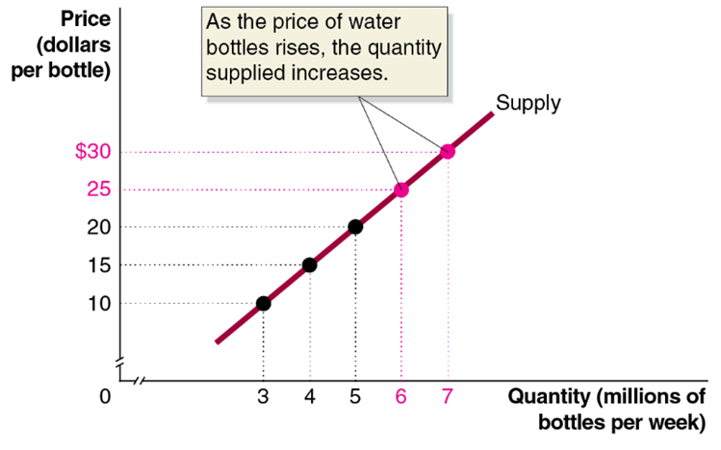
Figure 3.4 A Supply Schedule and Supply Curve (2 of 2)
Quantity supplied: The amount of a good or service that a firm is willing and able to supply at a given price.
Law of supply: A rule that states that, holding everything else constant, increases in price cause increases in the quantity supplied, and decreases in price cause decreases in the quantity supplied.
Notes:
The graph plots the price in dollars per bottle versus the quantity in millions of bottles per week. A line rises through the tabulated points and represents the supply. Points (6, $25) and (7, $30) are highlighted, as the price of water bottle rises, the quantity supplied increases.

Slide 28
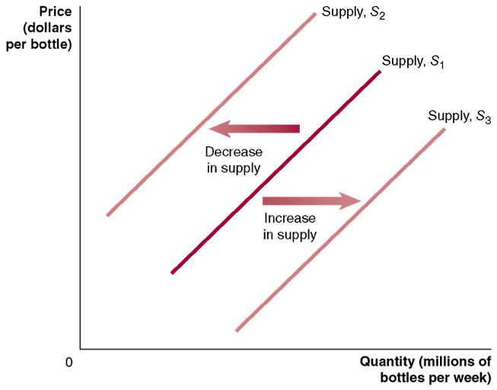
Figure 3.5 Shifting the Supply Curve (1 of 2)
A change in something other than price that affects supply causes the entire supply curve to shift.
A shift to the right
is an increase in supply.
A shift to the left
is a decrease in supply.
Notes:
The graph plots the price in dollars per bottle versus the quantity in millions of bottles per week. The supply line S sub 1 rises diagonally through the center of the graph. A decrease in supply causes the supply curve to shift to the left and is labeled, S sub 2. An increase in supply causes the supply curve to shift to the right and is labeled, S sub 3.

Slide 29
Figure 3.5 Shifting the Supply Curve (2 of 2)
As the supply curve shifts, the quantity supplied will change, even if the price doesn’t change.
The quantity supplied changes at every possible price.
Notes:
The graph plots the price in dollars per bottle versus the quantity in millions of bottles per week. The supply line S sub 1 rises diagonally through the center of the graph. A decrease in supply causes the supply curve to shift to the left and is labeled, S sub 2. An increase in supply causes the supply curve to shift to the right and is labeled, S sub 3.

Slide 30
What Variables Shift Market Supply?
Prices of inputs
Technological change
Prices of related goods in production
Number of firms in the market
Expected future prices
Natural disasters and pandemics
We will discuss how each of these affect supply.

Slide 31
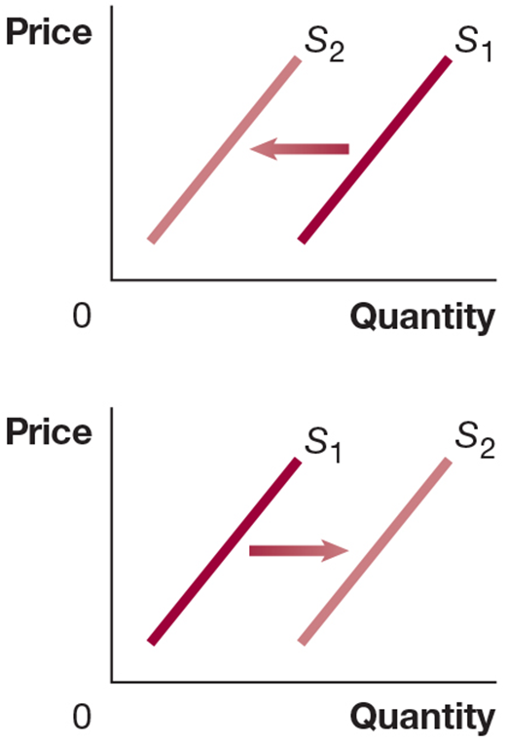
Change in Prices of Inputs
Inputs are anything used in the production of a good or service.
For a reusable water bottle, this includes plastic, labor, and transportation services.
An increase in the price of input decreases the profitability of selling the good, causing a decrease in supply.
A decrease in the price of an input increases the profitability of selling the good, causing an increase in supply.
Notes:
Supply line S sub 1 rises though the graph, and is shifted upward following the same path, becoming supply line S sub 2. On a graph, the X axis represents quantity, and the Y axis represents price. Supply line S sub 1 rises though the graph, and is shifted downward following the same path, becoming supply line S sub 2.

Slide 32
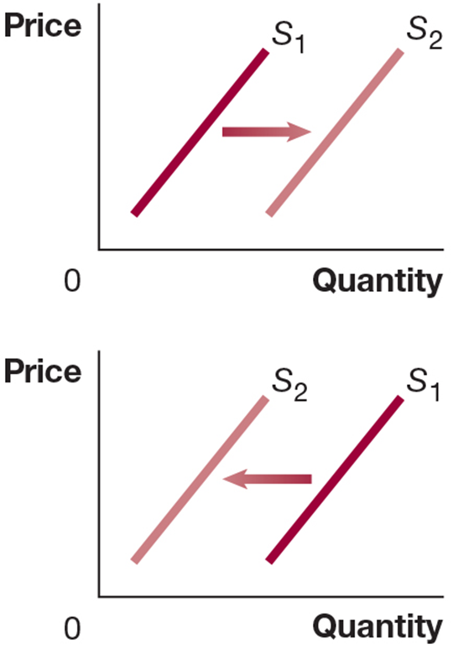
Technological Change
A firm may experience a positive or negative change in its ability to produce a given level of output with a given quantity of inputs. We call this a technological change.
Examples:
A new, more efficient way of producing water bottles would increase their supply.
Governmental restrictions on how much workers are allowed to work might decrease the supply of water bottles.
Notes:
Supply line S sub 1 rises though the graph, and is shifted downward following the same path, becoming supply line S sub 2. On a graph, the X axis represents quantity, and the Y axis represents price. Supply line S sub 1 rises though the graph, and is shifted upward following the same path, becoming supply line S sub 2.

Slide 33
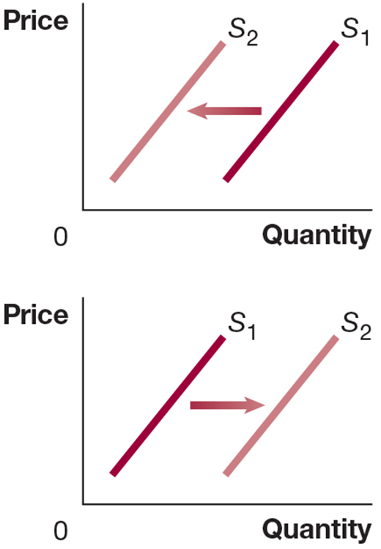
Prices of Related Goods in Production
Many firms can produce and sell alternative products: substitutes in production.
Example: An Illinois farmer can plant either corn or soybeans. If the price of soybeans rises, that farmer will plant (supply) less corn.
Sometimes, two products are necessarily produced together: complements in production
Example: Cattle provide both beef and leather. An increase in the price of beef encourages more cattle farming, which increases the supply of leather.
Notes:
Supply line S sub 1 rises though the graph, and is shifted upward following the same path, becoming supply line S sub 2. On a graph, the X axis represents quantity, and the Y axis represents price. Supply line S sub 1 rises though the graph, and is shifted downward following the same path, becoming supply line S sub 2.

Slide 34
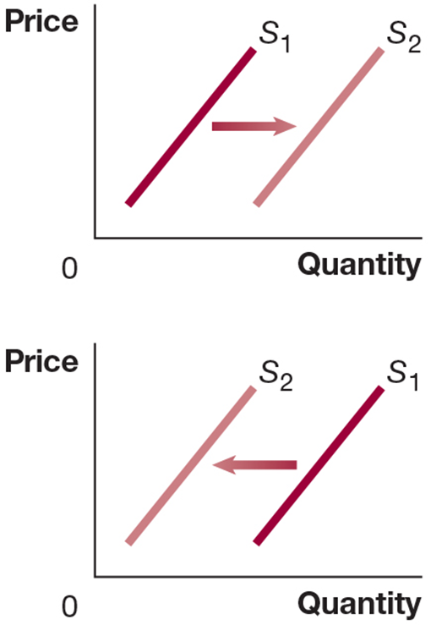
Number of Firms and Expected Future Prices
More firms in the market will result in more products available at a given price (greater supply).
If a firm anticipates that the price of its product will be higher in the future, it might decrease its supply today in order to increase it later.
Notes:
Supply line S sub 1 rises though the graph, and is shifted downward following the same path, becoming supply line S sub 2. On a graph, the X axis represents quantity, and the Y axis represents price. Supply line S sub 1 rises though the graph, and is shifted upward following the same path, becoming supply line S sub 2.

Slide 35
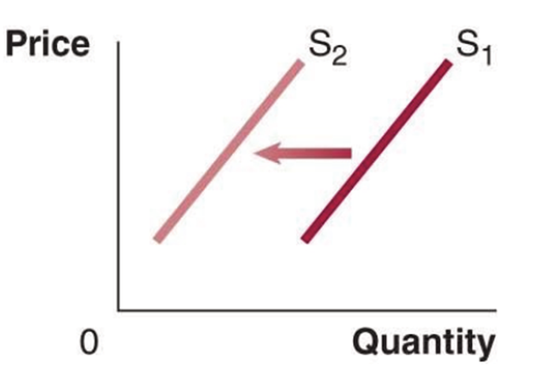
Natural Disasters and Pandemics (3 of 3)
Less of a good will be supplied due to disruptions in production
Example: During hurricanes and floods, some manufacturing plants will be damaged and forced to shut down. The result will be fewer units supplied.
Notes:
In the graph, the Supply line S sub 1 rises though the graph, and is shifted upward following the same path, becoming supply line S sub 2.

Slide 36
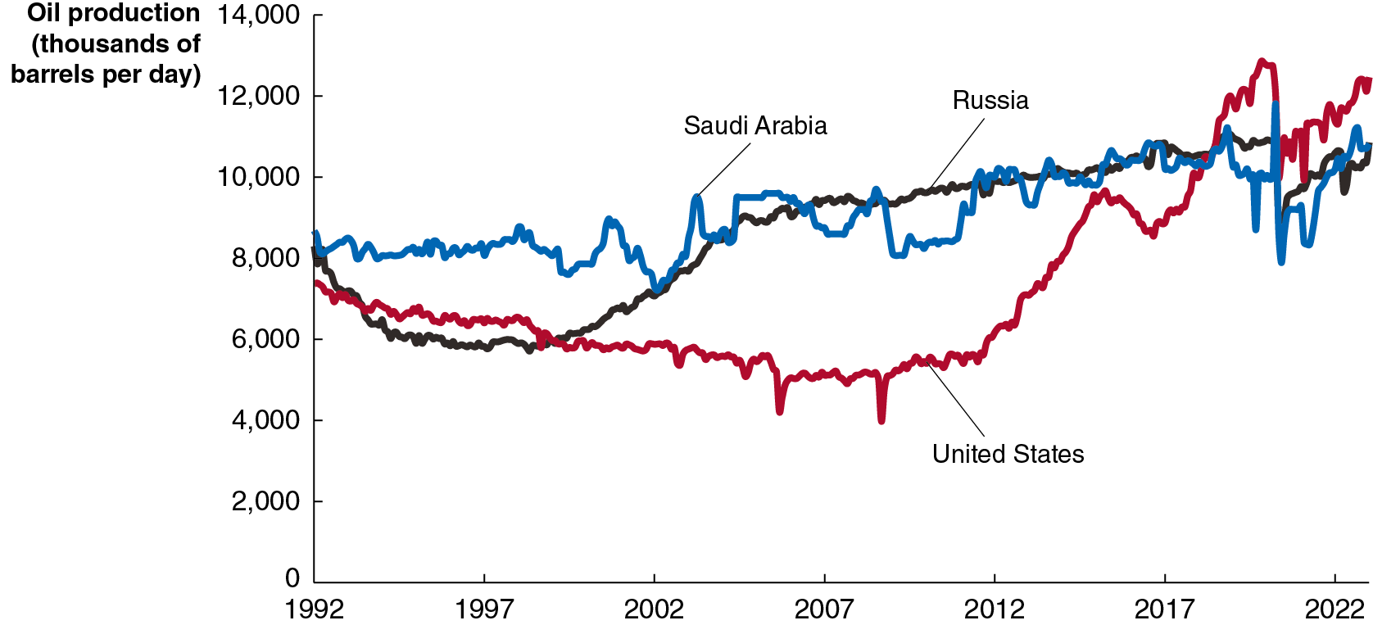
Apply the Concept: Fracking, the U.S. Oil Boom, and Expected Oil Prices
The development of hydraulic fracturing (fracking) disrupted the world oil market, propelling the U.S. to be the world’s largest oil producer.
In 2016 and during the Covid-19 pandemic, U.S. oil producers believed the price of oil was temporarily low. Each time they reduced current production, intending to sell more later when prices recovered.
Notes:
The horizontal axis plots the years and ranges from 1992 to 2022 in increments of 5 years. The vertical axis represents oil production of thousands of barrels per day and ranges from 0 to 14000 in increments of 2000. The data plotted are as follows.
The curve for Saudi Arabia is shaded in blue. The curve starts at (1992, 8300), rises and falls intermittently, and passes through (1997, 8000), (2002, 7950), (2007, 8500), (2012, 10,000), (2017, 10,000), and ends at (2022, 10150).
The curve for Russia is shaded in black. The curve starts at (1992, 8000), rises and falls intermittently, and passes through (1997, 6000), (2002, 7600), (2007, 9300), (2012, 9800), (2017, 10100), and ends at (2022, 10050).
The curve for the United States is shaded in red. The curve starts at (1992, 7500), rises and falls intermittently, and passes through (1997, 6500), (2002, 5900), (2007, 5700), (2012, 5800), (2017, 8100), and ends at (2022, 10700).

Slide 37
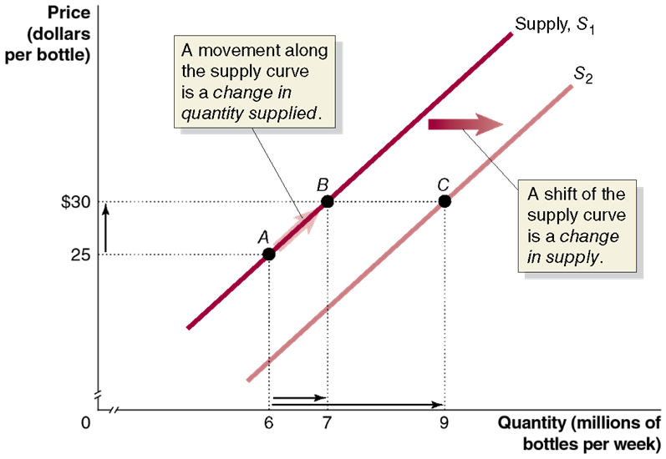
Figure 3.6 A Change in Supply Versus a Change in Quantity Supplied
A change in the price of the product being examined causes a movement along the supply curve.
This is a change in the quantity supplied.
Any other change affecting supply causes the entire supply curve to shift.
This is a change in supply.
Notes:
The X axis represents the quantity in millions of bottles per week, and the Y axis represents the price in dollars per bottle. Supply line S sub 1 rises through points A (6, $25) and B (7, $30). An arrow pointing from point A to point B indicates the movement along the supply curve is a change in the quantity supplied. An arrow points to the left and indicates a shift of the supply curve is a change in the supply, and the supply curve S sub 1 is labeled, S sub 2. Supply line 2 rises through point C (9, $30).

Slide 38
3.3 Market Equilibrium: Putting Demand and Supply Together
Use a graph to illustrate market equilibrium.
Market equilibrium is a situation in which quantity demanded equals quantity supplied.
Recall that markets with many buyers and sellers are perfectly competitive markets; a market equilibrium in one of these markets is called a competitive market equilibrium.
There are
firms selling reusable water bottles; we
will assume this is enough to generate competitive behavior in the market for reusable water bottles.

Slide 39
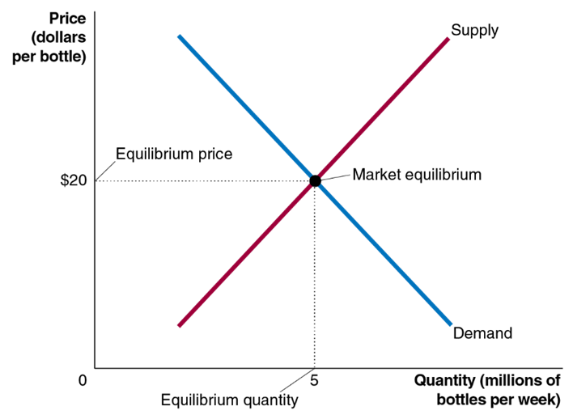
Figure 3.7 Market Equilibrium
At a price of $20,
consumers want to buy 5 million water bottles per week, and
producers want to sell 5 million water bottles per week.
We say the equilibrium price in this market is $20, and the equilibrium quantity is 5 million reusable water bottles per week.
Since buyers and sellers want to trade the same quantity at the price of $20, we do not expect the price to change.
Notes:
The X axis represents the quantity in millions of bottles per week, and the Y axis represents the price in dollars per bottle. The supply line rises through the graph and is shaded in red, and the demand line falls through the center of the graph and is shaded in blue. The curves intersect at (5, $20), which is labeled, market equilibrium. (5, 0) is the equilibrium quantity, and (0, $20) is the equilibrium price.

Slide 40
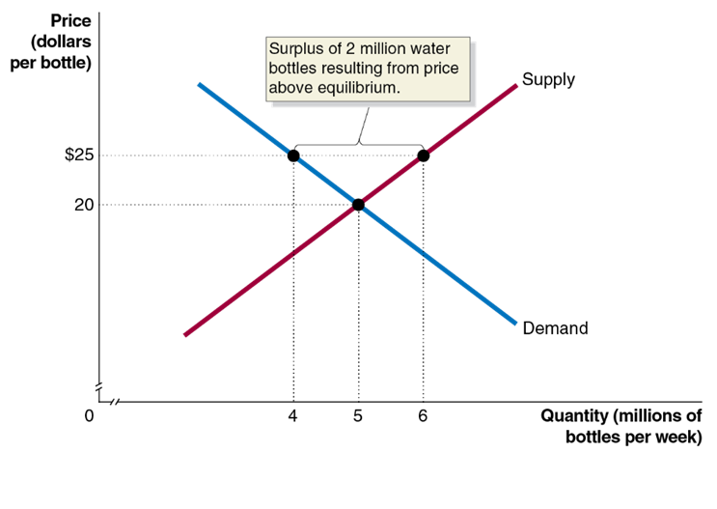
Figure 3.8 The Effect of Surpluses and Shortages on the Market Price (1 of 2)
What if the price were $25 instead?
At a price of $25,
consumers want to buy 4 million water bottles, while
producers want to sell 6 million water bottles.
This gives a surplus of 2 million water bottles: a situation in which the quantity supplied is greater than the quantity demanded.
Prediction: Sellers will compete among themselves, driving the price down.
Notes:
On the truncated graph, X axis represents the quantity in millions of bottles per week, and the Y axis represents the price in dollars per bottle. The red supply line rises through points (5, $20) and (6, $25). The blue demand line falls through points (4, $25) and (5, $20). The lines intersect at (5, $20). The distance between points (4, $25) and (6, $25) is the surplus of 2 million water bottles resulting from the price above equilibrium.

Slide 41
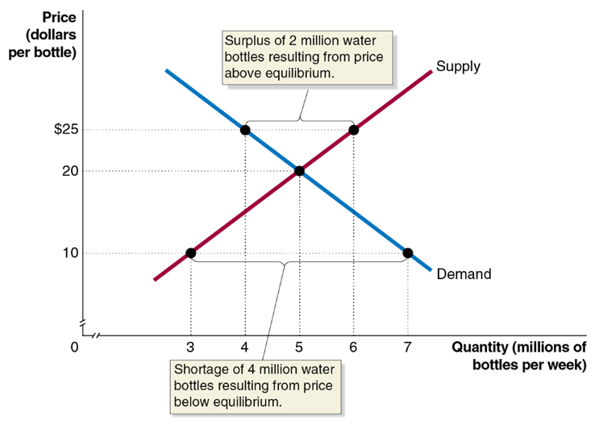
Figure 3.8 The Effect of Surpluses and Shortages on the Market Price (2 of 2)
Now what if the price were $10?
At a price of $10,
consumers want to buy 7 million water bottles, while
producers want to sell 3 million.
This gives a shortage of 4 million water bottles: a situation in which the quantity demanded is greater than the quantity supplied.
Prediction: Sellers will realize they can increase the price and still sell as many water bottles, so the price will rise.
Notes:
On the truncated graph, X axis represents the quantity in millions of bottles per week, and the Y axis represents the price in dollars per bottle. The red supply line rises through points (3, $10), (5, $20), and (6, $25). The blue demand line falls through points (4, $25), (10, $20), and (7, $10). The lines intersect at (5, $20). The distance between points (4, $25) and (6, $25) is the surplus of 2 million water bottles resulting from the price above equilibrium. The distance between points (3, $10) and (7, $10) is the shortage of 4 million water bottles resulting from price below equilibrium.

Slide 42
Demand and Supply Both Count
Price is determined by the interaction of buyers and sellers.
Neither group can dictate price in a competitive market (i.e., one with many buyers and sellers).
However, changes in supply and/or demand will affect the price and quantity traded.

Slide 43
3.4 The Effect of Demand and Supply Shifts on Equilibrium
Use demand and supply graphs to predict changes in prices and quantities.
Predictions about price and quantity in our model require us to know demand and supply curves.
Typically, we know price and quantity but do not know the curves that generate them.
The power of the demand and supply model is in its ability to predict directional changes in price and quantity.

Slide 44
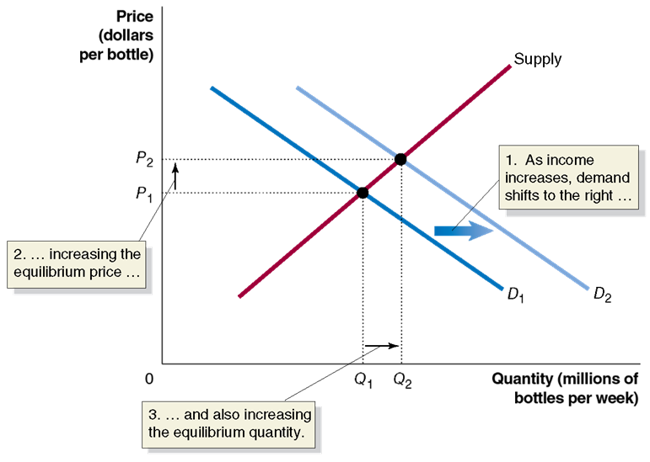
Figure 3.9 The Effect of an Increase in Demand on Equilibrium
Suppose incomes increase. What happens to the equilibrium in the reusable water bottle market?
Reusable water bottles are a normal good, so as income rises, demand shifts to the right
Equilibrium price rises
Equilibrium quantity rises
Notes:
The graph plots the price in dollars per bottle versus the quantity in millions of bottles per week. The supply line intersects the demand lines at (Q sub 1, P sub 1) and (Q sub 2, P sub 2). The demand line D sub 1 falls through the center of the graph. As income increases, the demand curve shifts to the right and becomes demand line D sub 2. The space between P sub 1 and P sub 2 is the increasing equilibrium price. The space between Q sub 1 and Q sub 2 is also increasing the equilibrium quantity.

Slide 45
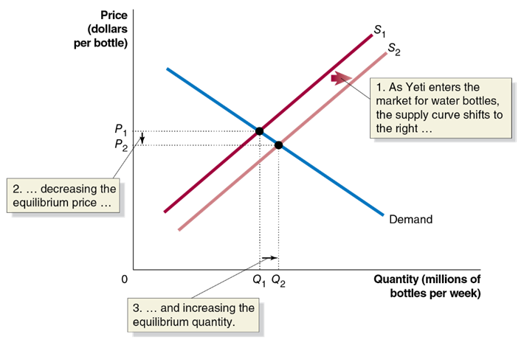
Figure 3.10 The Effect of an Increase in Supply on Equilibrium (1 of 2)
The graph shows the market for reusable water bottles as a new producer, Yeti, enters the market.
When Yeti enters, more water bottles are supplied at any given price—an increase in supply from
Equilibrium price falls from
Equilibrium quantity rises
Notes:
The X axis represents the quantity in millions of pairs of shoes per week, and the Y axis represents the price in dollars per pair of shoes. The demand line falls diagonally in the graph. The demand line intersects the supply lines at (Q sub 1, P sub 1) and (Q sub 2, P sub 2). The supply curve rises diagonally and passes through (Q sub 1, P sub 1). The distance between P sub 1 and P sub 2 is the decreasing equilibrium price. The distance between Q sub 1 and Q sub 2 is the increasing equilibrium quantity. Supply line S sub 1 shifts right as Yeti enters the market for water bottles, the supply curve shifts to the right and becomes supply line S sub 2. The curve S sub 2 passes through (Q sub 2, P sub 2).

Slide 46
Figure 3.10 The Effect of an Increase in Supply on Equilibrium (2 of 2)
By how much will the price fall? By how much will quantity rise?
We cannot say, without knowing more information.
For now, we can only predict that price will fall and quantity will rise.
Notes:
The X axis represents the quantity in millions of pairs of shoes per week, and the Y axis represents the price in dollars per pair of shoes. The demand line falls diagonally in the graph. The demand line intersects the supply lines at (Q sub 1, P sub 1) and (Q sub 2, P sub 2). The supply curve rises diagonally and passes through (Q sub 1, P sub 1). The distance between P sub 1 and P sub 2 is the decreasing equilibrium price. The distance between Q sub 1 and Q sub 2 is the increasing equilibrium quantity. Supply line S sub 1 shifts right as Yeti enters the market for water bottles, the supply curve shifts to the right and becomes supply line S sub 2. The curve S sub 2 passes through (Q sub 2, P sub 2).

Slide 47
Table 3.3 How Shifts in Demand and Supply Affect Equilibrium Price (P) and Quantity (Q) (1 of 2)
Blank | Supply Curve Unchanged | Supply Curve Shifts to the Right | Supply Curve Shifts to the Left
Demand Curve Unchanged | Q unchanged P unchanged | Q increases P decreases | Q decreases P increases
Demand Curve Shifts to the Right | Q increases P increases | Blank | Blank
Demand Curve Shifts to the Left | Q decreases P decreases | Blank | Blank
Notes:
The table summarizes what happens when the demand curve shifts or the supply curve shifts, with the other curve remaining unchanged.

Slide 48
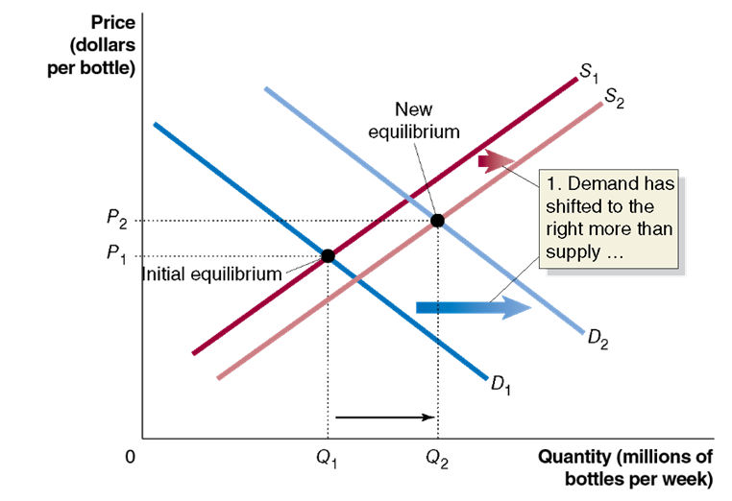
Figure 3.11 Shifts in Demand and Supply Over Time (1 of 3)
Over time, it is likely that both demand and supply will change.
For example, as new firms enter the market for water bottles and incomes increase, we expect:
The supply curve will shift to the right, and
The demand curve will shift to the right.
Notes:
The X axis represents the quantity in millions of bottles per week, and the Y axis represents the price in dollars per bottle. The graph represents demand shifting more than supply. Supply line S sub 1 rises through the graph, then shifts right to become line S sub 2. Demand line D sub 1 falls through the graph, intersecting S sub 1 at (Q sub 1, P sub 1), and shifts to the right to become line D sub 2. D sub 2 intersects curve S sub 2 at (Q sub 2, P sub 2). Point (Q sub 1, P sub 1) is the initial equilibrium, and (Q sub 2, P sub 2) is the new equilibrium. The shift of the supply curves is labeled, demand has shifted to the right more than the supply.

Slide 49
Figure 3.11 Shifts in Demand and Supply Over Time (2 of 3)
What does our model predict?
So we can be sure equilibrium quantity will rise, but the effect on the equilibrium price is not clear.
This panel shows demand shifting more than supply: equilibrium price and quantity both rise.
Notes:
The X axis represents the quantity in millions of bottles per week, and the Y axis represents the price in dollars per bottle. The graph represents demand shifting more than supply. Supply line S sub 1 rises through the graph, then shifts right to become line S sub 2. Demand line D sub 1 falls through the graph, intersecting S sub 1 at (Q sub 1, P sub 1), and shifts to the right to become line D sub 2. D sub 2 intersects curve S sub 2 at (Q sub 2, P sub 2). Point (Q sub 1, P sub 1) is the initial equilibrium, and (Q sub 2, P sub 2) is the new equilibrium. The shift of the supply curves is labeled, demand has shifted to the right more than the supply.

Slide 50
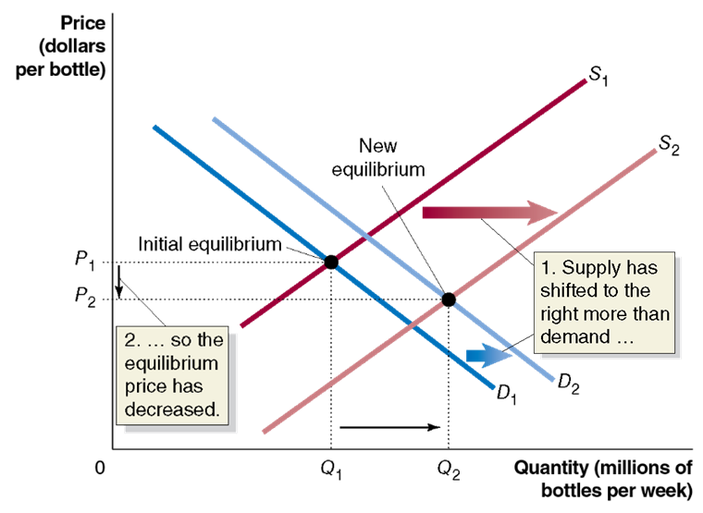
Figure 3.11 Shifts in Demand and Supply Over Time (3 of 3)
This panel shows supply shifting more than demand: quantity rises, but equilibrium price falls.
Without knowing the relative size of the changes, the effect on the equilibrium price is ambiguous.
It is possible, but unlikely, that the equilibrium price will remain unchanged.
Notes:
Graph B represents supply shifting more than demand. Supply line S 1 rises through the graph and shift right to become S sub 2, as the supply has shifted to the right more than demand. Demand line D 1 falls through the graph, and shifts right to become D sub 2. D sub 1 intersects S sub 1 at (Q sub 1, P sub 1), and D sub 2 intersects S sub 2 at (Q sub 2, P sub 2). Point (Q sub 1, P sub 1) is the initial equilibrium, and point (Q sub 2, P sub 2) is the new equilibrium. The space between P sub 1 and P sub 2 shows the equilibrium price has decreased.

Slide 51
Table 3.3 How Shifts in Demand and Supply Affect Equilibrium Price (P) and Quantity (Q) (2 of 2)
Blank | Supply Curve Unchanged | Supply Curve Shifts to the Right | Supply Curve Shifts to the Left
Demand Curve Unchanged | Q unchanged P unchanged | Q increases P decreases | Q decreases P increases
Demand Curve Shifts to the Right | Q increases P increases | Q increases P increases, decreases, or is unchanged | Q increases, decreases, or is unchanged P increases
Demand Curve Shifts to the Left | Q decreases P decreases | Q increases, decreases, or is unchanged P decreases | Q decreases P increases, decreases, or is unchanged
The cell in red is the example that we just saw.

Slide 52
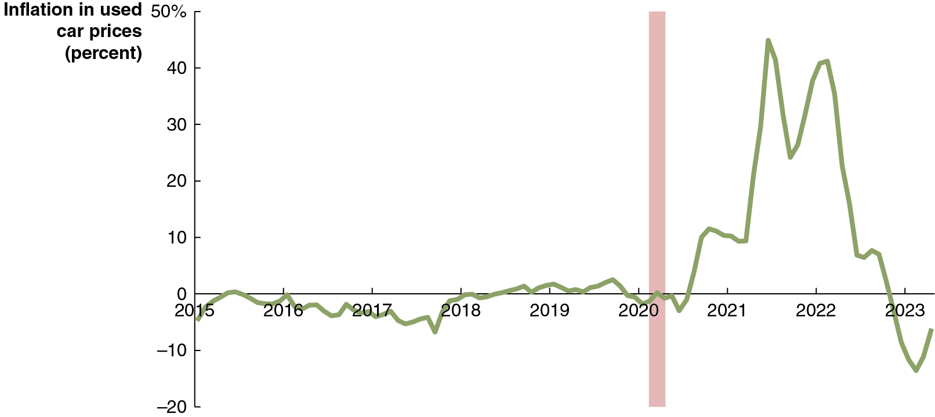
Apply the Concept: Sticker Shock in the Market for Used Cars (1 of 2)
Leading up to 2020, prices for many goods (including used cars) had been stable for a long time.
But beginning in 2020, prices for used cars started rising at rates not seen for decades.
Notes:
The horizontal axis ranges from 2015 to 2023 in increments of 1 year. The vertical axis ranges from negative 20% to 50% in increments of 10%. The graph plots a curve that starts at (2015, negative 3%), (2016, 0%), (2018, 0%), (2019, 2%), (2020, negative 2), (2021, 9%), (2022, 35%), and (2023, negative 10%).

Slide 53
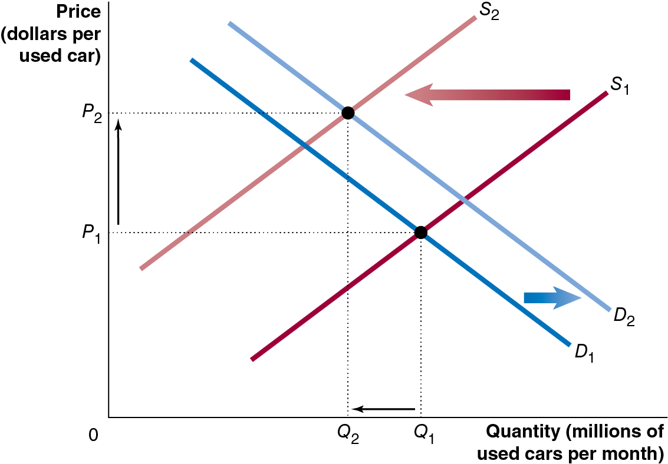
Apply the Concept: Sticker Shock in the Market for Used Cars (2 of 2)
Why did prices rise?
Supply shortages for new cars ‘drove’ increases in demand for used cars.
Rental car companies reduced their fleets, removing a major source of used cars.
The graph shows both of these effects, each of which increased prices.
Notes:
The graph plots the price in dollars per used car versus the quantity in millions of used cars per month. The demand curve falls diagonally through the graph. The curve D sub 1 shifts to the right and is labeled, D sub 2. The supply curve S sub 1 rises diagonally and intersects the falling demand curve D sub 1 at (Q sub 1, P sub 1). The supply curve shifts to the left and is labeled, S sub 2. The curve S sub 2 intersects the curve D sub 2 at (Q sub 2, P sub 2).

Slide 54
Shifts of a Curve versus Movements Along a Curve
Suppose an increase in supply occurs. We now know:
Equilibrium quantity will increase, and
Equilibrium price will decrease.
It is tempting to believe the decrease in price will cause an increase in demand. But this is incorrect.
The decrease in price will cause a movement along the demand curve but not an increase in demand.
Why? The demand curve already describes how much of the good consumers want to buy, at any given price.
When the price change occurs, we just look at the demand curve to see what happens to how much consumers want to buy.

Slide 55

Copyright
This work is protected by United States copyright laws and is provided solely for the use of instructors in teaching their courses and assessing student learning. Dissemination or sale of any part of this work (including on the World Wide Web) will destroy the integrity of the work and is not permitted. The work and materials from it should never be made available to students except by instructors using the accompanying text in their classes. All recipients of this work are expected to abide by these restrictions and to honor the intended pedagogical purposes and the needs of other instructors who rely on these materials.

